Slide 1
Hotel Reservations research
By omer shalom, asif rot
iD 204124945, 315312249

Slide 2
Project Overview and Objective
The main purpose of this project was to build models that would answer some questions using the dataset provided. Each model would attempt to learn the dataset and make a prediction using its algorithm.

Slide 3
The dataset
Dataset was Taken from: https://www.kaggle.com/datasets/ahsan81/hotel-reservationsclassification-dataset
The file contains the different attributes of customers' reservation details.
Data Dictionary:
Booking_ID: unique identifier of each booking
no_of_adults: Number of adults
no_of_children: Number of Children
no_of_weekend_nights: Number of weekend nights (Saturday or Sunday) the guest stayed or booked to stay at the hotel
no_of_week_nights: Number of week nights (Monday to Friday) the guest stayed or booked to stay at the hotel
type_of_meal_plan: Type of meal plan booked by the customer:
required_car_parking_space: Does the customer require a car parking space? (0 - No, 1- Yes)
room_type_reserved: Type of room reserved by the customer. The values are ciphered (encoded) by INN Hotels.
lead_time: Number of days between the date of booking and the arrival date
arrival_year: Year of arrival date
arrival_month: Month of arrival date
arrival_date: Date of the month
market_segment_type: Market segment designation.
repeated_guest: Is the customer a repeated guest? (0 - No, 1- Yes)
no_of_previous_cancellations: Number of previous bookings that were canceled by the customer prior to the current booking.
no_of_previous_bookings_not_canceled: Number of previous bookings not canceled by the customer prior to the current booking
avg_price_per_room: Average price per day of the reservation; prices of the rooms are dynamic. (in euros)
no_of_special_requests: Total number of special requests made by the customer (e.g., high floor, view from the room, etc.)
booking_status: Flag indicating if the booking was canceled or not.

Slide 4
The research Questions
Q1. What factors most influence the booking status (cancelled or not cancelled)?
Q2. How does the number of adults, children, and special requests affect the average price per room?
Q3. What is the impact of the number of previous cancellations on the booking status?
Q4. Is it possible to predict an order cancellation?
Note: We divided the dataset into two parts: 80% for training, 20% for testing.

Slide 5
Our Techniques
Linear Regression: is a supervised machine learning algorithm used for predicting a continuous target variable based on one or more predictor variables. The basic idea behind linear regression is to find the best linear relationship between the target variable and the predictor variables.
Random Forest: is an ensemble machine learning algorithm that can be used for both classification and regression problems. The basic idea behind Random Forest is to combine the predictions of multiple decision trees to improve the overall accuracy of the model.
Logistic Regression: is a type of supervised machine learning algorithm used for binary classification problems. The goal of logistic regression is to predict a binary outcome (e.g., yes/no, 0/1) based on one or more predictor variables.
Decision Trees: is a type of supervised machine learning algorithm used for both classification and regression problems. It works by creating a tree-like model that splits the data into smaller and smaller subgroups based on the values of the input features. Each split is represented by a node in the tree, and each leaf node represents a prediction for the target variable.
KNN: (K-Nearest Neighbors) is a machine learning algorithm that is commonly used for classification and regression problems. KNN is a non-parametric algorithm, meaning it doesn't make any assumptions about the underlying distribution of the data. KNN is a simple algorithm that uses the distance metric to identify the k-nearest neighbors to a new data point and classify it based on the majority class of the k-nearest neighbors.
SVM: (Support Vector Machines) is a machine learning algorithm that is commonly used for classification and regression problems. SVM is a linear model that tries to find a hyperplane that separates the data into two or more classes. The hyperplane is chosen in such a way that it maximizes the margin between the classes. SVM is a powerful algorithm that can handle both linear and non-linear problems, making it useful for various applications.

Slide 6
Algorithms Description Summary - q1
This algorithm performs a binary classification task on the dataset using random forest and decision tree classifiers.
It preprocesses the data by dropping a column, one-hot encoding categorical columns, and scaling the data.
The data is split into training and test sets, and the classifiers are trained on the training data.
Finally, the feature importance of the trained classifiers is displayed using the showInfo() function.

Slide 7
Algorithms Description Summary – Q2
This algorithm prepares the dataset for training three regression models: Linear Regression, Random Forest, and Decision Tree.
It then splits the data into training and test sets, trains the models, makes predictions on the test set, and evaluates each model using mean absolute error.
Finally, it creates a scatter plot of the actual values and the predictions for each model, and it generates bar charts of the average price per room by the number of adults, children, and special requests.

Slide 8
Algorithms Description Summary – q3
This algorithm demonstrates the use of four different classification models (Random Forest, Logistic Regression and Decision Tree and KNN) to predict the booking status of hotel reservations based on the number of previous cancellations.
The dataset is loaded, prepared, and split into training and test sets using the pandas and scikit-learn libraries.
The accuracy of each model is then calculated and printed to the console.

Slide 9
Algorithms Description Summary – q4
In order to answer that question, we would use a few different ML techniques which used for classification and regression problems: Linear Regression, Logistic Regression, Random Forest, KNN, SVC.
The algorithm gets the dataset after preprocessing and check the relations between the relevant features and the order cancellation label.
Each model will answer the question with the accuracy rate he predicted.
Finally, the algorithm reports the prediction accuracy of each model and checks if any of the models overfits the data.

Slide 10

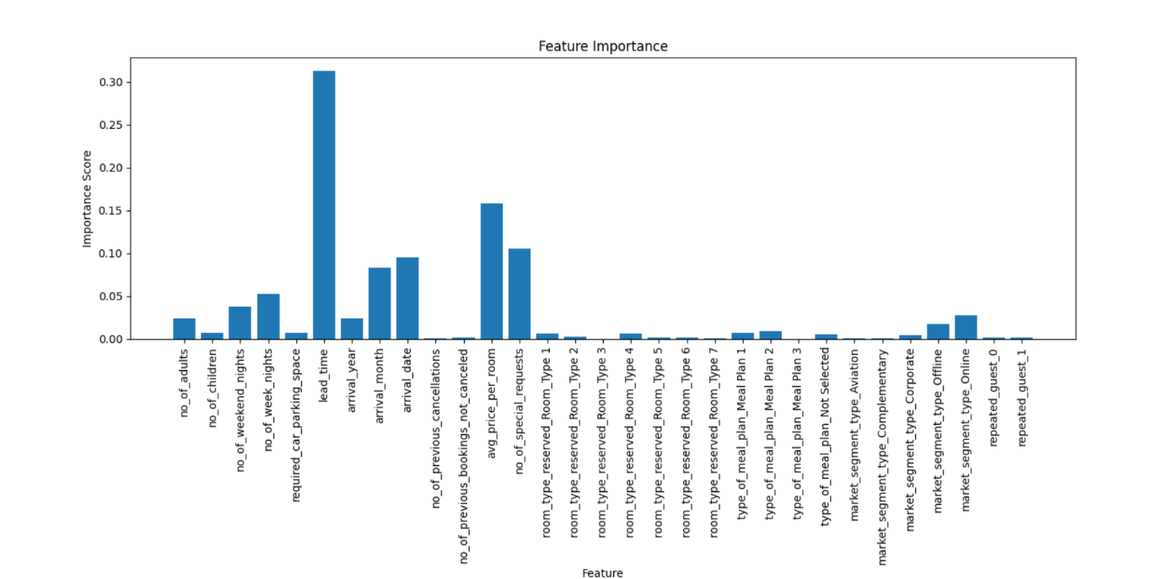
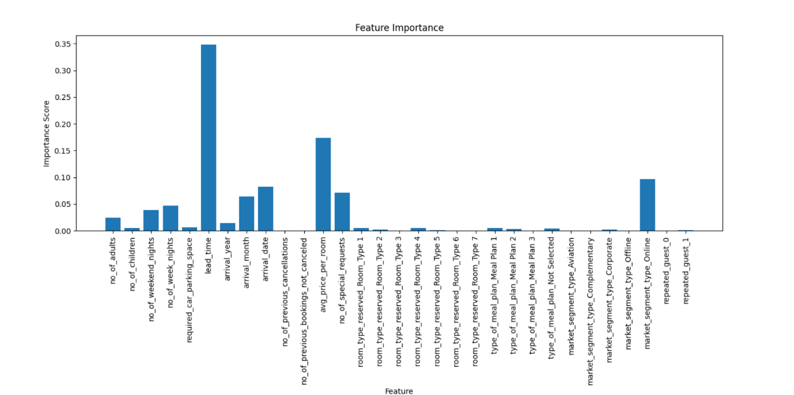
RESULTS - What factors most influence the booking status (cancelled or not cancelled)?
Figure 1. Feature importance by Random Forest.
Figure 2. Feature importance by Decision Tree.
Based on the feature importance values that the Random Forest Classifier and Decision Tree Classifier classes returned,
the feature that has the highest importance for predicting whether a booking will be canceled or not is the 'lead_time' feature.
It has an importance score of 0.31132 (Random Forest) or 0.34635 (Decision Tree), which is higher than any other feature in the dataset (on both models).
Actually, It is very reasonable - The higher the lead_time is, there is more chances of unpredictable events to cause for a cancellation.

Slide 11
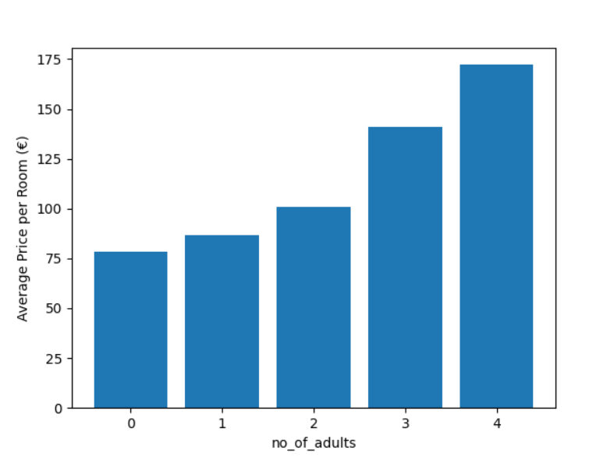
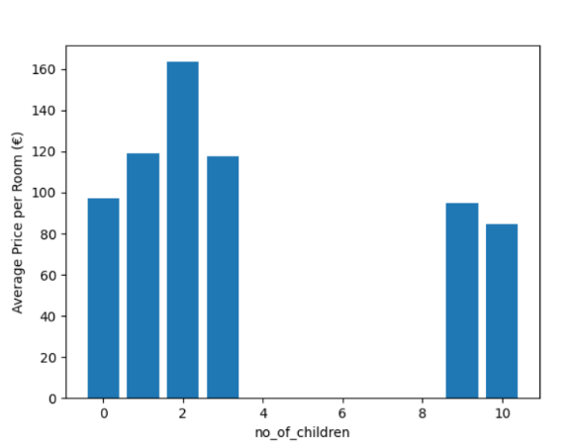
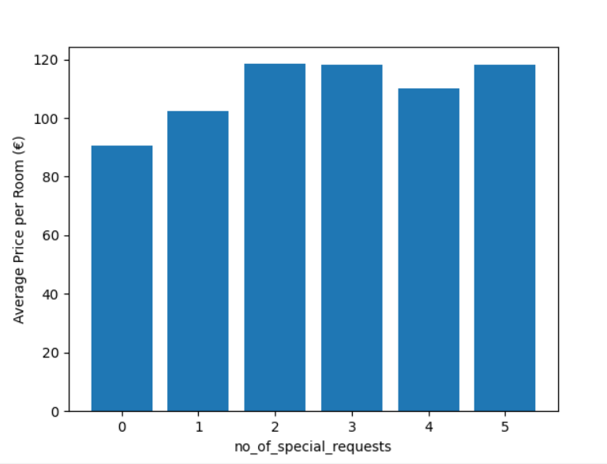
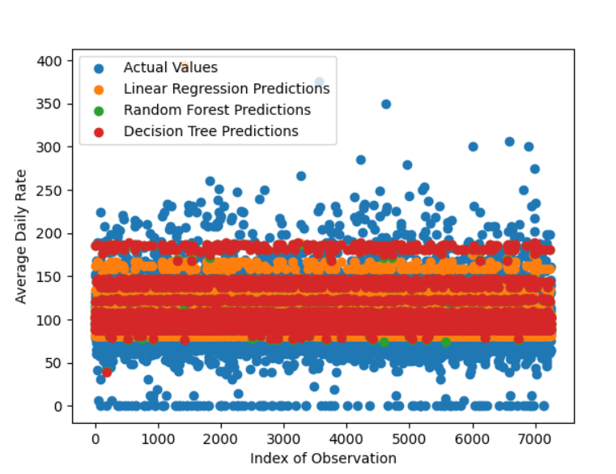
Results - How does the number of adults, children, and special requests affect the average price per room?
Based on the figures, Number of adults has the largest impact on avg price per room.
Additionally, we can see by the figures that the 2 other features (Number of children, number of special requests) are not increasing monotonically, that means they don’t impact directly on the average price per room.
Here we can see the models prediction accuracy rate relative to the actual values:

Slide 12
Results - What is the impact of the number of previous cancellations on the booking status?
Based on the results of the code and the fact that only the no_of_previous_cancellations feature is used for training the models, we can infer that the number of previous cancellations has some impact on the booking status.
Looking at the accuracy scores of the different models, we can see that they are all relatively low (and even), with around 66% accuracy rate.
This suggests that the no_of_previous_cancellations feature alone may not be sufficient to accurately predict the booking status, and other features may need to be considered.
The reason why we are getting the same accuracy for all four models (Random Forest, Logistic Regression, Decision Tree and KNN) is because we are using only one feature 'no_of_previous_cancellations' to train the models, which may not have a strong correlation with the target variable 'booking_status'. As a result, the models may not be able to capture the underlying patterns and relationships in the data, leading to similar accuracy scores.

Slide 13
Results - Is it possible to predict an order cancellation?
Yes, its possible.
Based on the accuracy of all models that are not overfitted, we can obtain a prediction for order cancellation.
We can see the knn model is overfitting!
The model which has the best accuracy is Random Forest Classifier – with 0.90723638869745 accuracy rate.

Slide 14
Conclusion
The analysis of the hotel booking dataset showed that various factors can impact the average price per room, including the number of adults, children, and special requests. However, the impact of the number of previous cancellations on the booking status is less clear, and it seems that other factors may be more influential in determining whether a booking is canceled or not.
Finally, various features such as lead time, arrival date, and length of stay were found to be important in predicting whether a booking would be canceled, and several machine learning techniques were used to predict order cancellations with a reasonable level of accuracy.
Overall, the analysis highlights the importance of considering multiple factors when analyzing hotel booking data and the potential of using machine learning to make predictions and inform decision-making.

Slide 15
Difficulties and solutions
Feature selection: Given the large number of features, selecting the most relevant ones was challenging. We solved it by A combination of the knowledge we acquired during the semester and by feature importance analysis (After deciding which questions we are going to ask; it was easier to analyze which features we need)
Same results: To answer question 3, we tried 4 different models and got exactly the same accuracy on all of them, which is strange. After some research, we found out that it is because the feature set consists of only 1 feature (according to the question). When we tried to add a random feature, we saw that the accuracy had changed in all models. Nevertheless, we decided to leave it with the one feature - according to the question.
Model selection: Given the questions we have to answer, we didn't know which model to choose for each question. After learning about each model and its purpose (classification or regression), we were able to select them accordingly.

